Slide 1

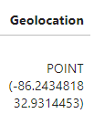
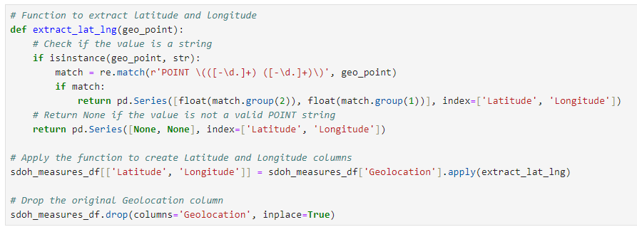

Data Cleaning and Database Prep
SDOH Measures for County, ACS 2017-2021
data.cdc.gov

Slide 2
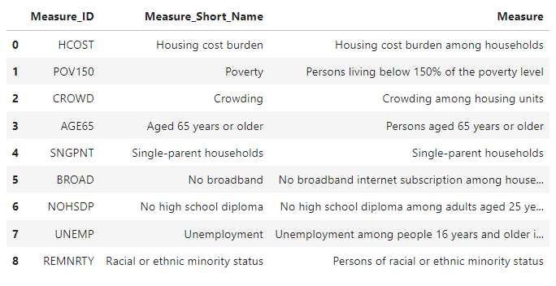
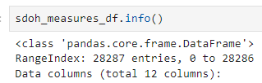

Data Cleaning and Database Prep
SDOH Measures for County, ACS 2017-2021
data.cdc.gov

Slide 3
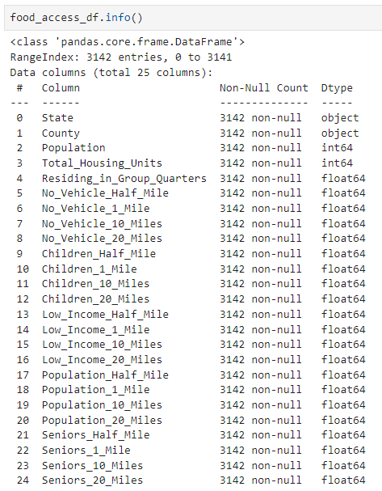
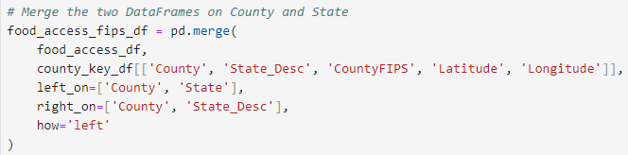
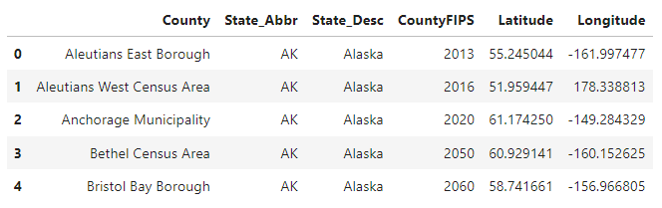
Data Cleaning and Database Prep
🍕US Food Access
www.kaggle.com/datasets

Slide 4
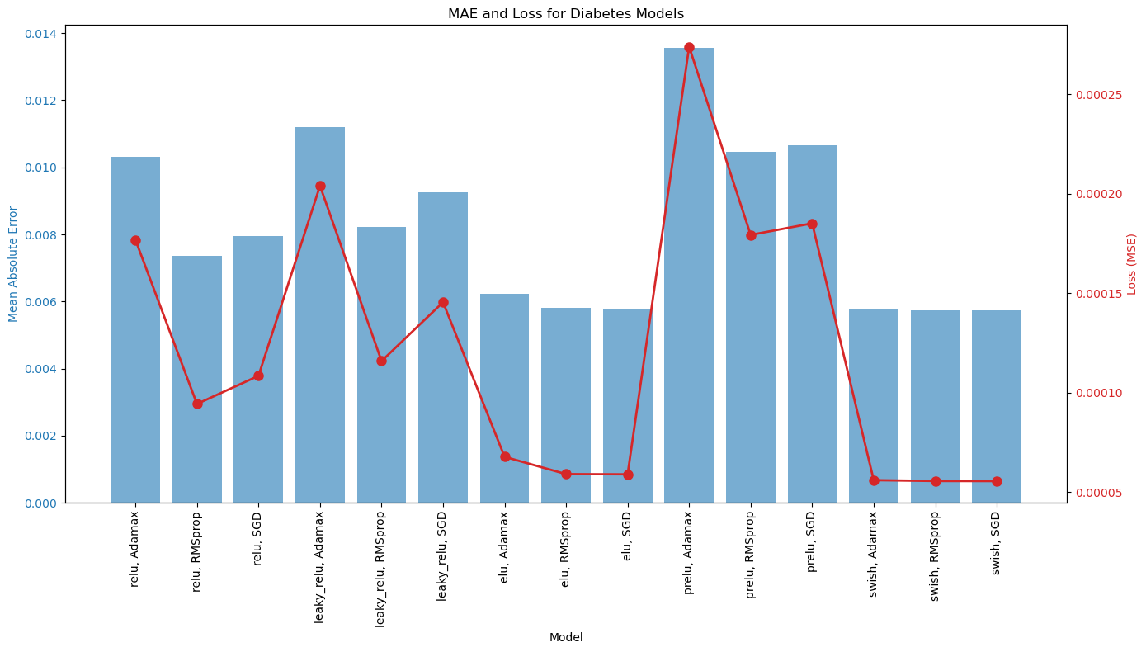
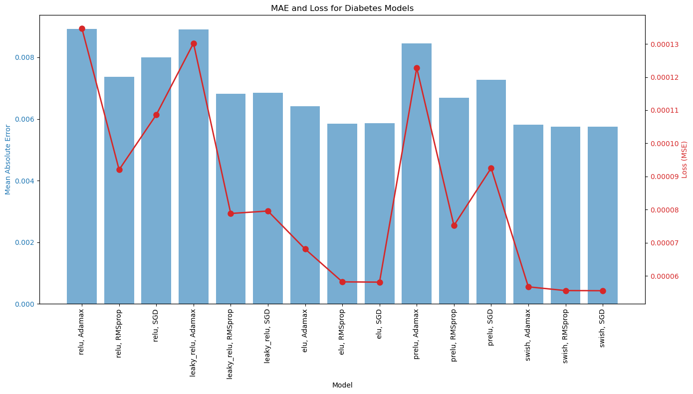
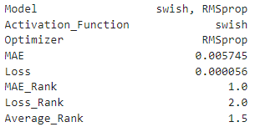
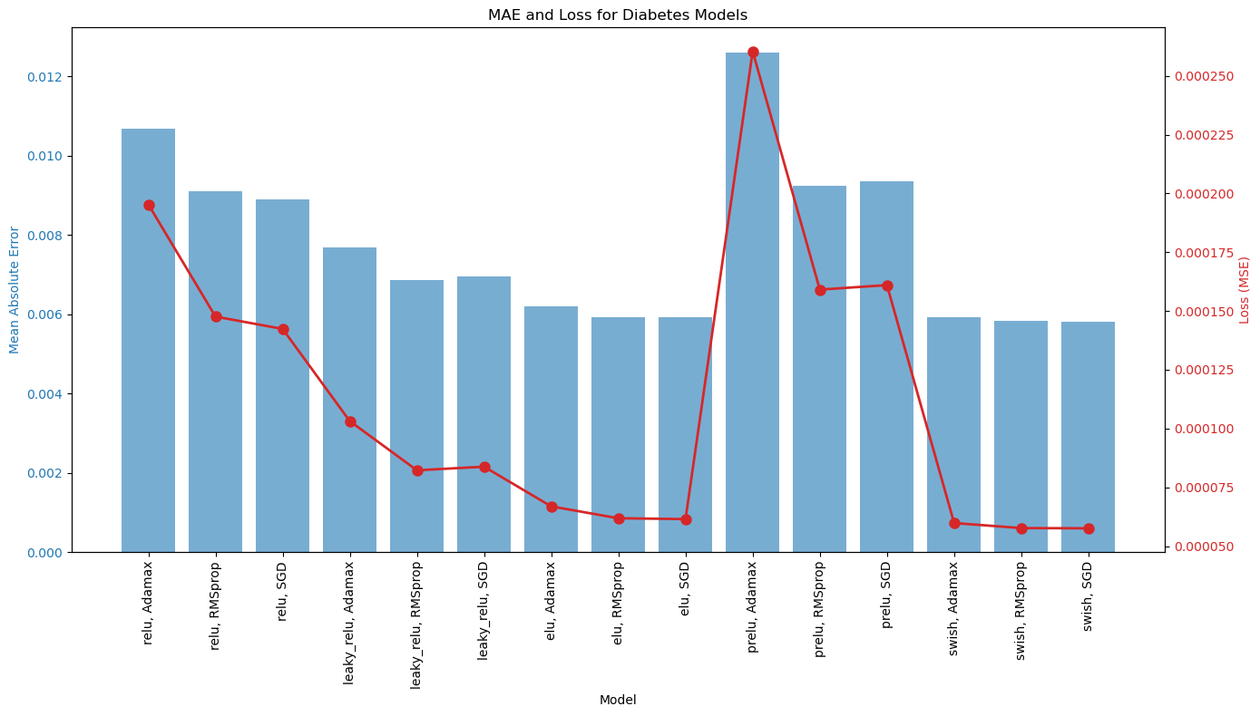
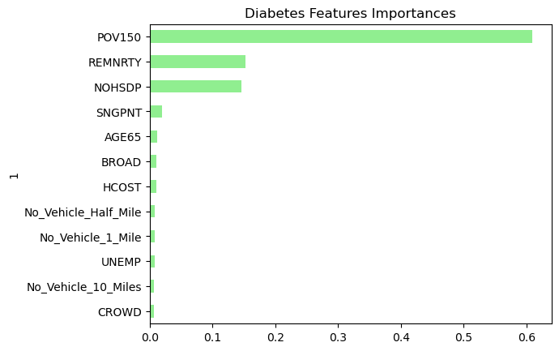
Diabetes Optimization Function

Slide 5
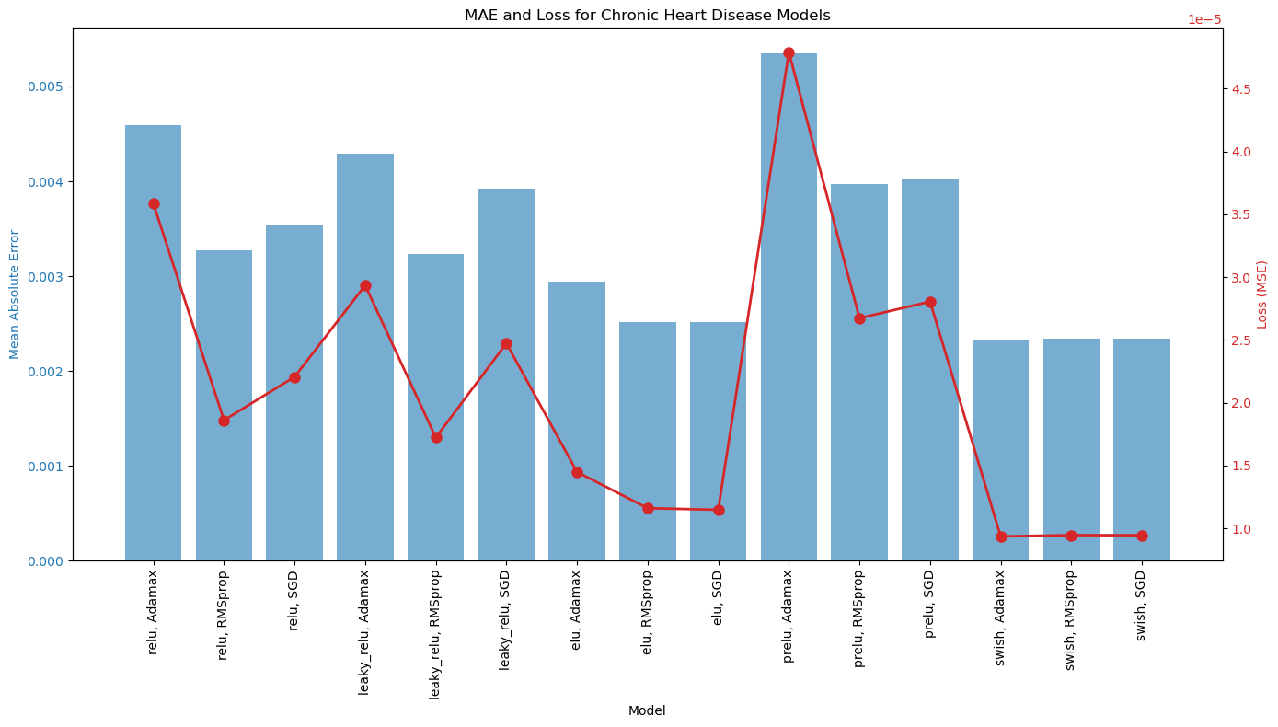
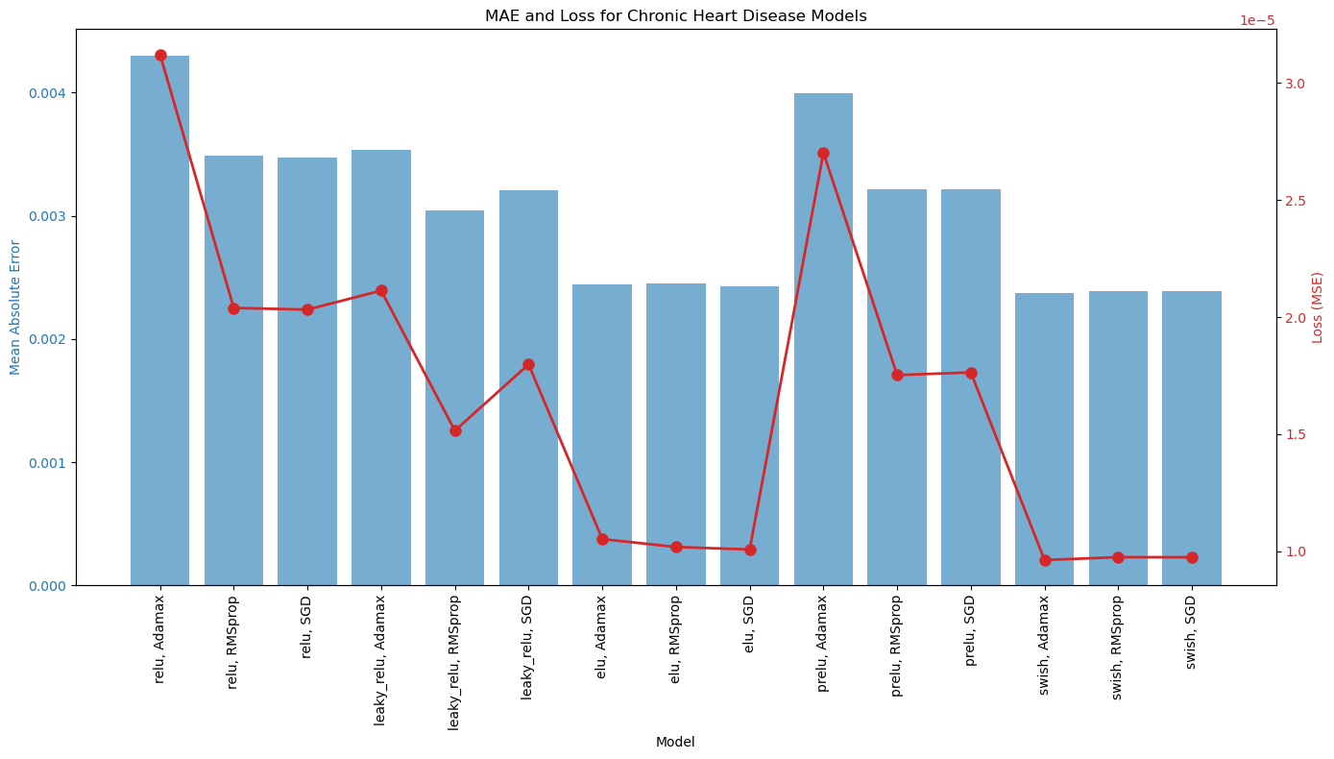
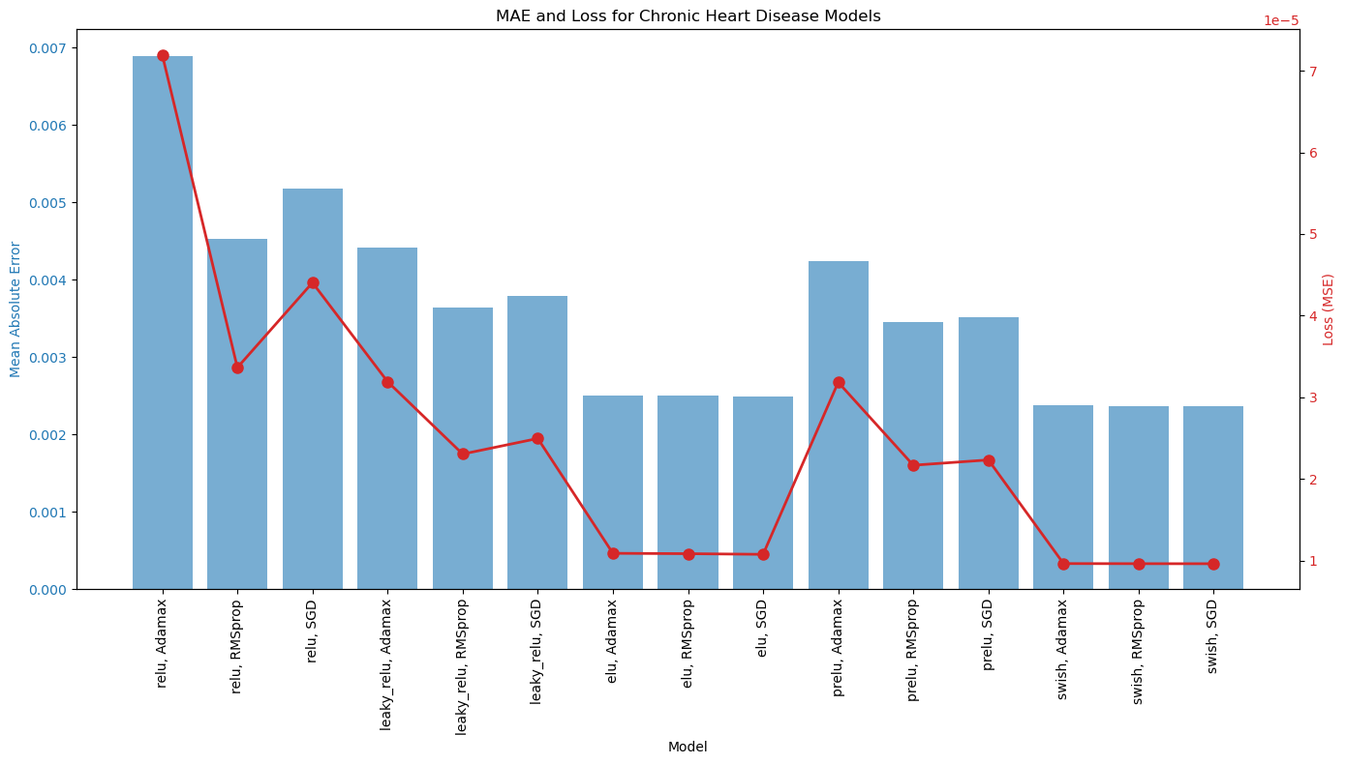
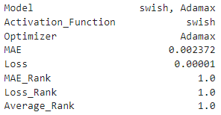
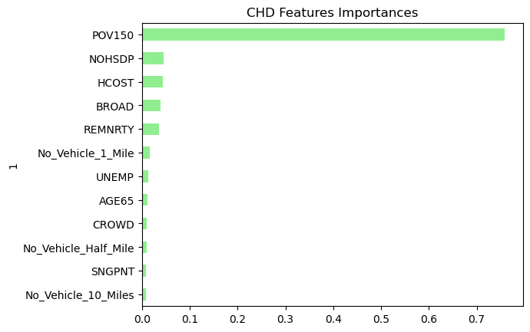
Chronic Heart Disease Optimization Function

Slide 6
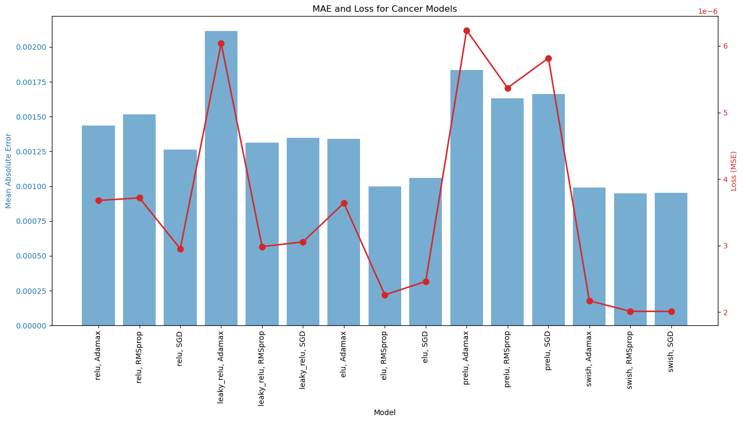
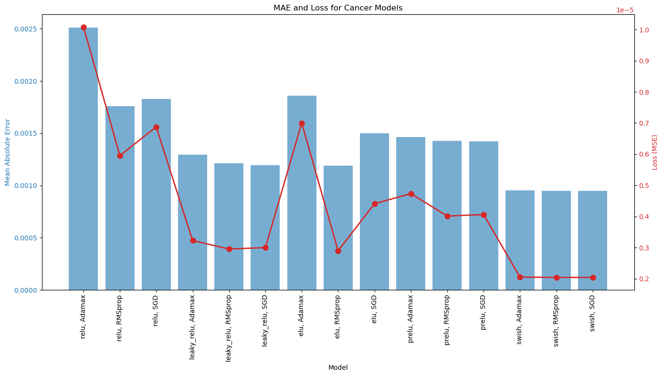
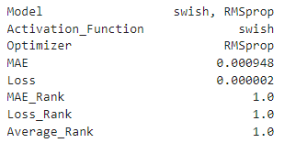
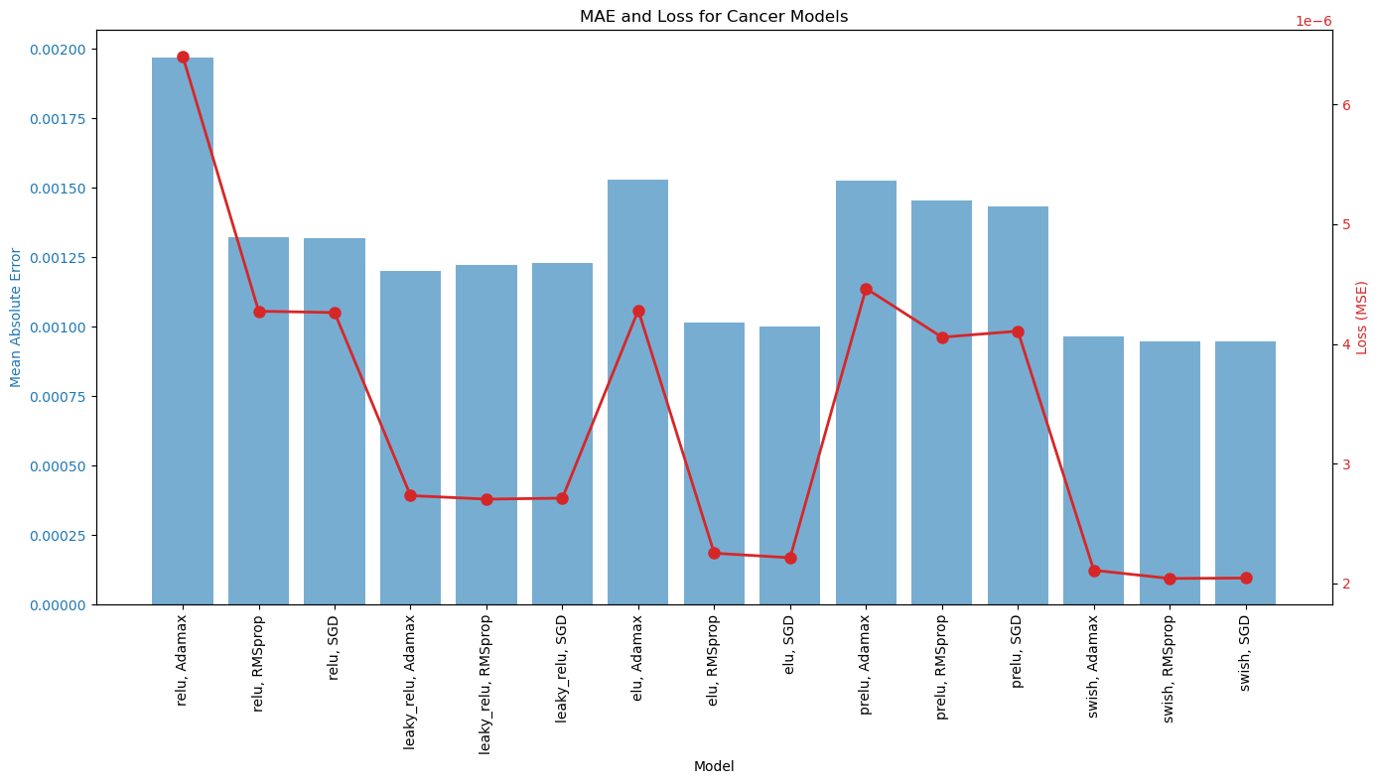
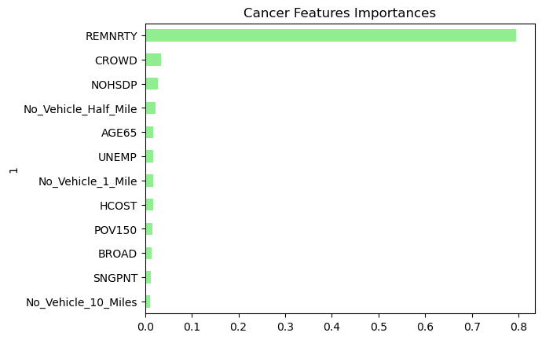
Cancer Optimization Function

Slide 7
About us
At Contoso, we empower organizations to foster collaborative thinking to further drive workplace innovation. By closing the loop and leveraging agile frameworks, we help business grow organically and foster a consumer first mindset.

Slide 8

Company overview

Slide 9
Problem
Market gap: few, if any, products on the market help customers like we do
Customers: 66% of US consumers spend money on multiple products that only partially resolves their issue
Financials: millennials account for about a quarter of the $48 billion spent on other products in 2018
Costs: loss of productivity costing consumers thousands of dollars
Usability: customers want something easy to use that helps make their life easier

Slide 10

Product benefits
Online store and market swap

Slide 11
Product overview
Unique
First to market
Tested
Authentic
Only product specifically dedicated to this niche market
First beautifully designed product that's both stylish and functional
Conducted testing with college students in the area
Designed with the help and input of experts in the field

Slide 12

Growth strategy
Feb 20XX: roll out product to high profile or top-level participants to help establish the product
May 20XX: release the product to the public and monitor press release and social media accounts
Oct 20XX: gather feedback and adjust product design as necessary

Slide 13
Market overview
Opportunity to build
Fully inclusive market
Total addressable market
Freedom to invent
Selectively inclusive market
Serviceable available market
 | Clients | Orders | Gross revenue | Net revenue
20XX | 10 | 1100 | $10,000 | $7,000
20XX | 20 | 200 | $20,000 | $16,000
20XX | 30 | 300 | $30,000 | $25,000
20XX | 40 | 400 | $40,000 | $30,000

Slide 14
Financials
 | Year 1 | Year 2 | Year 3
Income
Users | 50,000 | 400,000 | 1,600,000
Sales | 500,000 | 4,000,000 | 16,000,000
Average price per sale | 75 | 80 | 90
Revenue @ 15% | 5,625,000 | 48,000,000 | 216,000,000
Gross profit | 5,625,000 | 48,000,000 | 216,000,000

Slide 15

Thank you
Brita Tamm
502-555-0152
brita@firstupconsultants.com
www.firstupconsultants.com

